Slide 1
CSOPESY Semi-Major Output 1
Technical Report
Group Members
Aquino, Bon
Dela Cruz, Karl Matthew
Espinosa, Jose Miguel
Pineda, Dencel

Slide 2
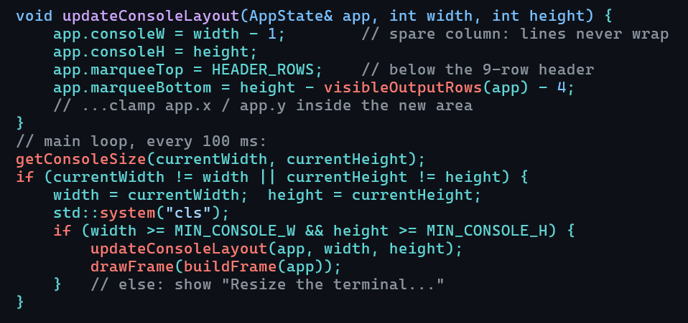
Console UI Implementation
The UI fills the whole console window ( getConsoleSize() ).
Layout from top to bottom: header, marquee area, ==== separator, status line, prompt, output.
updateConsoleLayout() recalculates the areas and keeps the marquee inside them.
The window size is checked every 100 ms. On a resize, the screen is cleared and the layout is recalculated.
The window must be at least 60×25. The cursor is hidden while running and restored on exit.

Slide 3
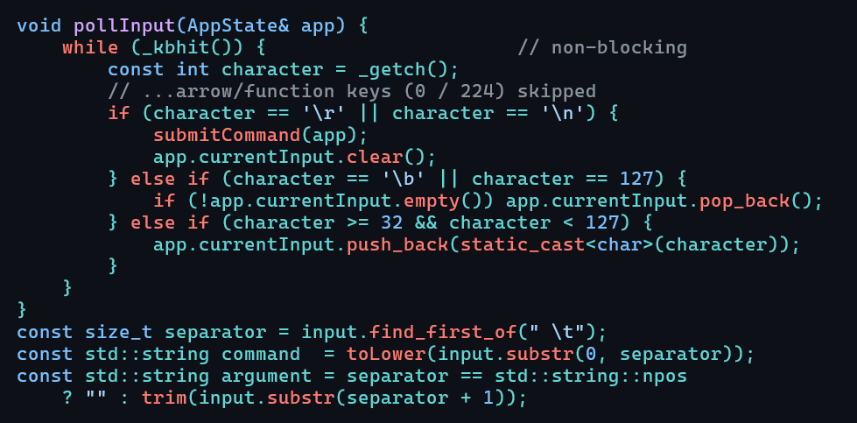
Command Interpreter Implementation
pollInput() reads keys with _kbhit() and _getch() without blocking, so the animation never waits for typing.
Printable keys are added to the input, Backspace deletes, Enter submits, and arrow keys are ignored.
submitCommand() trims the input, splits the command from its argument, lowercases the command, then runs it.
Unknown commands show an error, and wrong or extra arguments show a Usage: message. set_speed only accepts 1–60000.

Slide 4
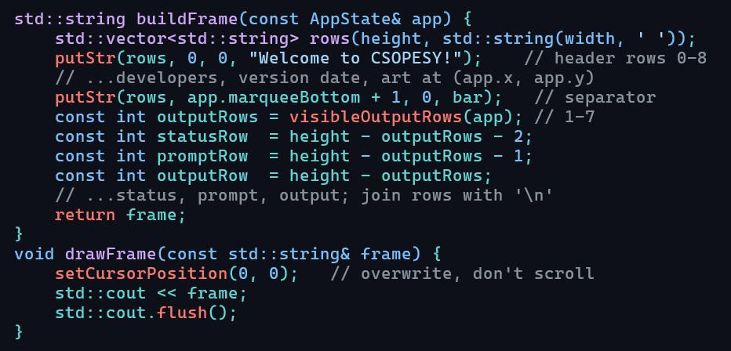
Display Implementation
buildFrame() creates a blank text grid the size of the console on every redraw.
putStr() writes text at a given row and column, cut off at the grid edges.
Drawing order: header, marquee art at (x, y) with spaces left transparent, separator, status, prompt with input and _ , output.
The output area sizes itself to the message (1–7 lines), and the marquee gets the remaining rows.
All rows are joined into one string. drawFrame() moves the cursor to (0,0) and overwrites the screen, so nothing scrolls.

Slide 5
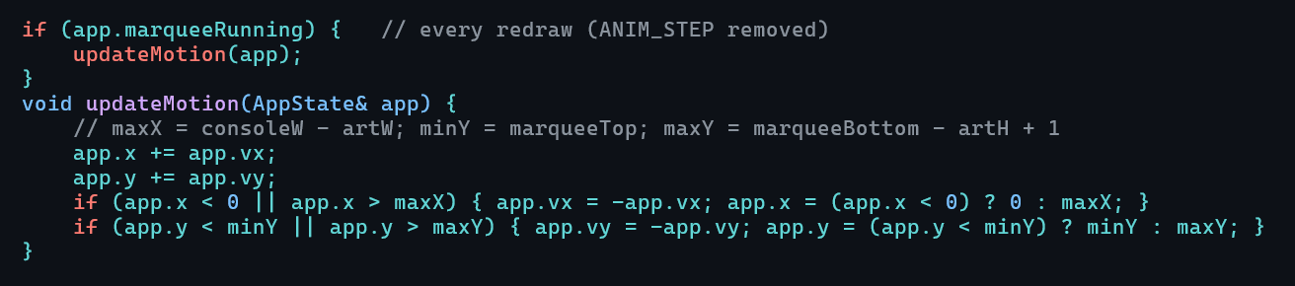
Marquee Animation Logic
AppState stores the position (x, y) and the direction (vx, vy, each +1 or −1).
The art moves one cell per redraw, so its speed is set by the refresh interval ( set_speed ).
Bounds: x goes from 0 to consoleW − art width, and y from marqueeTop to marqueeBottom − art height + 1.
At an edge, the direction flips and the position is pulled back inside, so the art bounces.
After a resize or an output change, the art is pulled back inside the marquee area.
stop_marquee only pauses movement; the screen keeps refreshing. set_text replaces the art and restarts it near the top-left.

Slide 6
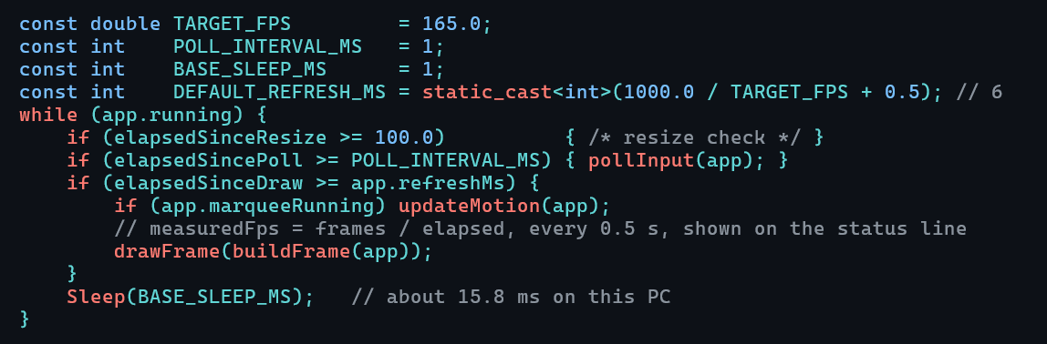
Finding the Balance
set_speed changes both the redraw rate and the marquee speed.
Measured on this PC (Ryzen 5 5600G): Sleep(1) actually takes about 15.8 ms (Windows' default timer), so the loop only runs about 63 times a second. That gives about 63 FPS at 6 ms, and input is really polled about every 16 ms.
Measured set_speed results: 1–15 ms all give about 63 FPS, 16 gives about 52, 17 about 31, and 33 about 21.
Recommended for this PC: keep the 6 ms refresh (any value up to 15 ms reaches the maximum) and the 1 ms polling.
Limits: No tearing or flicker even at 1 ms and typing lag noticeable at 500ms.

